Slide 1
CSCE 465 Computer & Network Security
Instructor: Abner Mendoza

Slide 2
Authentication (III)
Trusted Intermediaries

Slide 3
Roadmap
Basics
Kerberos
Public Key Infrastructure (PKI)

Slide 4
Trusted Intermediaries
Problem: authentication for large networks
Solution #1
Key Distribution Center (KDC)
Representative solution: Kerberos
Based on secret key cryptography
Solution #2
Public Key Infrastructure (PKI)
Based on public key cryptography

Slide 5

Kerberos

Slide 6
Goals of Kerberos
User ↔ server mutual authentication
Users should only need to authenticate once to obtain services from multiple servers
Should scale to large numbers of users and servers
makes use of a Key Distribution Center so servers don’t need to store information about users

Slide 7
Some Properties
Kerberos uses only secret key (symmetric) encryption
originally, only DES, but now 3DES and AES as well
A stateless protocol
KDCs do not need to remember what messages have previously been generated or exchanged
the state of the protocol negotiation is contained in the message contents

Slide 8
Example Scenario
Alice wants to make use of services from X, contacts the KDC to authenticate, gets ticket to present to X
Bob wants to make use of services from X and Y, contacts the KDC, gets tickets to present to X and Y
Server X
Alice
KDC
Bob
Server Y

Slide 9
The KDC
Infrastructure needed (KDC components)
the database of user information (IDs, password hash, shared secret key, etc.)
an authentication server (AS)
a ticket-granting server (TGS)
The KDC of course is critical and should be carefully guarded

Slide 10
Passwords and Tickets
Alice provides a password when she logs into her workstation
Alice’s workstation…
derives Alice’s master key from the password
asks the KDC for a temporary session key K_{A}
The KDC provides a ticket-granting ticket (TGT) for Alice to use; eliminates need for…
…repeated authentication
…further use of master key
Notes:
What is function of K_A?
Kerberos uses as its basis the Needham-Schroeder protocol. It makes use of a trusted third party, termed a key distribution center (KDC), which consists of two logically separate parts: an Authentication Server (AS) and a Ticket Granting Server (TGS). Kerberos works on the basis of "tickets" which serve to prove the identity of users.
The KDC maintains a database of secret keys; each entity on the network — whether a client or a server — shares a secret key known only to itself and to the KDC. Knowledge of this key serves to prove an entity's identity. For communication between two entities, the KDC generates a session key which they can use to secure their interactions.

Slide 11
Kerberos v4 Protocol Sketch
Alice
#1 Login + Password
Alice’s Workstation
KDC
#2 Alice wants to authenticate
#3 Here’s Alice’s TGT
#4 Request service from V
#5 Alice wants service from V
#6 Here is key + ticket to use
#7 Here is Alice’s ticket for service + key to use
Server V
#8 Alice’s request for service is granted, using key supplied

Slide 12
Msg#3: TGT
K_{KDC}(ID_{A} | Addr_{A} | K_{A-KDC} | Lifetime_{TGT} | TS_{TGT} | ID_{KDC})
The TGT is what allows the KDC to be stateless
means simpler, more robust KDC design
allows replicated KDCs
The TGT contains
the session key to be used henceforth
the user ID (Alice)
the valid lifetime for the TGT

Slide 13
V5: Some Differences with v4
v5 uses ASN.1 syntax to represent messages
a standardized syntax, not particularly easy to read
but, very flexible (optional fields, variable field lengths, extensible value sets, …)
v5 extends the set of encryption algorithms
v5 supports much longer ticket lifetimes
v5 allows “Pre-authentication” to thwart password attacks
v5 allows delegation of user access / rights
Notes:
v4 has reached end of life by MIT
advantages claimed for v5: support for strong encryption, extensibility, and fixes of bugs in cross-realm
authentication used by v4

Slide 14
Realms
A realm is a group of resources sharing a single authority for authorization
frequently the same as a DNS domain, and referred to by the domain name (e.g., “cse.tamu.edu”)
A realm consists of…
KDC (TGS, AS, and database)
users
servers

Slide 15
Inter-Realm Authentication
What if a user wants access to services located in a different realm?
Simple solution: require Alice to be registered in each realm, has to undergo separate authentication in each
More complex solution: the KDCs cooperate to perform inter-realm authentication
these KDCs must have previously-negotiated shared secret keys
receiving KDC can decide for itself whether to accept credentials issued by another KDC

Slide 16
Example
Alice
Requests TGT for local TGS
TGT for local services
Requests TGT for remote TGS
local KDC
TGT for remote services
Realm A
Requests ticket for remote server
Ticket for remote service
Ticket for remote server
Realm B
Grants service
remote KDC
Remote Server

Slide 17
Kerberos Summary
Kerberos is the most widely used authentication service
Modeled on the Needham-Schroeder protocol, but adds the TGT
v5 extends and fixes problems of v4; v4 no longer in active use
Inter-realm authentication scales to very large systems (e.g., the Internet)

Slide 18
Public Key Infrastructure

Slide 19
What Is PKI
Informally, the infrastructure supporting the use of public key cryptography.
A PKI consists of
Certificate Authority (CA)
Certificates
A repository for retrieving certificates
A method of revoking certificates
A method of evaluating a chain of certificates from known public keys to the target name

Slide 20
Certification Authorities (CA)
A CA is a trusted node that maintains the public keys for all nodes (Each node maintains its own private key)
1
2
5
CA
3
6
4
If a new node is inserted in the network, only that new node and the CA need to be configured with the public key for that node

Slide 21
Certificates
A CA is involved in authenticating users’ public keys by generating certificates
A certificate is a signed message vouching that a particular name goes with a particular public key
Example:
[Alice’s public key is 876234]_{carol}
[Carol’s public key is 676554]_{Ted} & [Alice’s public key is 876234]_{carol}
Knowing the CA’s public key, users can verify the certificate and authenticate Alice’s public key

Slide 22
Certificates
Certificates can hold expiration date and time
Alice keeps the same certificate as long as she has the same public key and the certificate does not expire
Alice can append the certificate to her messages so that others know for sure her public key
Notes:
Someone can impersonate Alice

Slide 23
CA Advantages
The CA does not need to be online. [Why?]
If a CA crashes, then nodes that already have their certificates can still operate.
Certificates are not security sensitive (in terms of confidentiality).
Can a compromised CA decrypt a conversation between two parties?
Can a compromised CA fool Alice into accepting an incorrect public key for Bob, and then impersonate Bob to Alice?
Notes:
No
Yes

Slide 24
CA Problems
What if Alice is given a certificate with an expiration time and then is revoked (fired) from the system?
Alice can still use her certificate till the expiration time expires.
What kind of harm can this do?
Alice can still exchange messages with Bob using her un-expired certificate.
Solution:
Maintain a Certificate Revocation List (CRL) at the CA. A Certificate is valid if (1) it has a valid CA signature, (2) has not expired, and (3) is not listed in the CA’s CRL list.

Slide 25
PKI Models
Monopoly model
Monopoly + Registration Authorities (RA)
Delegated CAs
Oligarchy model
Anarchy model (Web of Trust): fully distributed
Name constraints
Top-down with name constraints
Bottom-up with name constraints (hierarchical name space, similar to DNS)

Slide 26
Certificate Revocation
Certificates for public keys (Campus IDs) might need to be revoked from the system
Someone is fired
Someone graduated
Someone’s certificate (card) is stolen

Slide 27
Certificate Revocation
Certificates typically have an associated expiration time
Typically in the order of months (too long to wait if it needs to be revoked)
Solutions:
Maintain a Certificate Revocation List (CRL)
A CRL is issued periodically by the CA and contains all the revoked certificates
Each transaction is checked against the CRL

Slide 28
CRLs
Why are CRLs issued periodically even if no certificates are revoked?
How frequent should CRLs be issued?
If a CRL is maintained, why associate an expiration time with certificates?
Notes:
Otherwise an attacker can issue an old CRL and claim it is the most recent
To reduce the CRL size

Slide 29
Delta CRL
Certificates (1) may be huge, and (2) need to be issued periodically
A Delta CRL includes lists changes from the last complete CRL
Delta CRLs may be issued periodically (frequently) and full CRLs are issued less frequently

Slide 30
On-line Revocation Servers (OLRS)
An OLRS is a system that can be queried over the network for the revocation status of individual certificates
An OLRS maintains the full CRL list
What if someone impersonates an OLRS?
…..
Solution?
…..
Notes:
He can say that a valid certificate is valid and an invalid certificate is valid
A good authentication scheme is needed

Slide 31
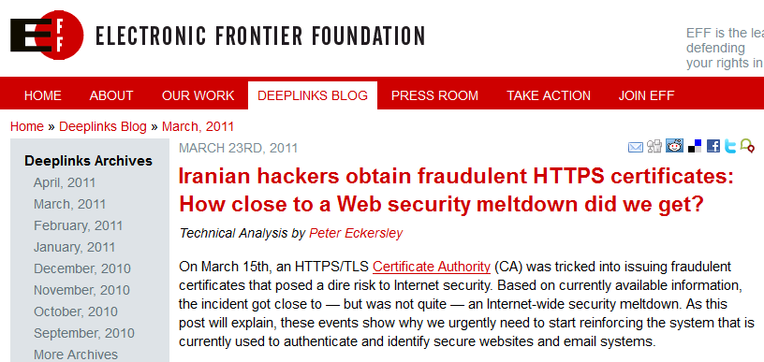
Famous Attack on CA

Slide 32
Recent Attack on CA
9 fraudulently issued certificates from Comodo include following domains:
mail.google.com, www.google.com, login.yahoo.com, login.skype.com, login.live.com, addons.mozilla.org, global trustee
The master CA private keys in its Hardware Security Modules (HSMs) were not compromised
The future?

